Slide 1
IND5003
Sentiment analysis from stocktiwks

Slide 2
What is Sentiment analysis?
Explain that it is part of NLP but is not covered in our NLP lecture.
Explain the common usage of SA
And their usefulness – business, politics etc
And explains that there are some journals about people exploring tweets from Twitter to determine stock movement, and we want to evaluate the usefulness of it ourselves
But using different platform.. StockTwits

Slide 3

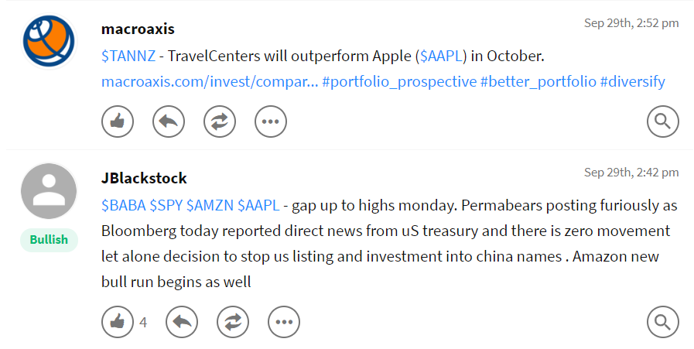
Stocktwit
StockTwits is a Twitter-like social media platform designed for sharing ideas between investors, traders, and entrepreneurs.
We are using the comments in StockTwits to determine the sentiments towards Apple Inc.
We can explain that just by reading the comments, we cant really tell about their sentiment strength per comments.
We can quantify each comments using Sentiment Analysis and then generate an aggregate sentiment of the day/hour.
We will also run several ML model to predict future price movement from the SA

Slide 4
How the data was extracted?
Explain here and the codes used

Slide 5
Pre-processing
As we all know social media posts can be very messy – weird usage of symbols, spelling errors, etc.
Hence a lot of cleaning was required
But its almost to make correct everything into proper sentences
Example of the raw data:
 | Title | Title_link | st_2jbUWIi | st_3SL2gug | st_1NNeqUz | st_28bQfzV | st_1NNeqUz1 | st_3xRimaf | lib_XwnOHoV | likes
0 | jekoz | https://stocktwits.com/jekoz | https://s3.amazonaws.com/st-avatars/images/def... | 𝐷𝐼𝑆𝑛𝑜𝑡ℎ𝑖𝑛𝑔𝑐𝑎𝑛𝑔𝑒𝑡𝑡ℎ𝑖𝑠𝑜𝑣𝑒𝑟140.𝑀𝑎𝑦𝑏𝑒DISnothingcangetthisover140.MaybeAAP... | $DIS | Sep 17th, 8:40 am | $AAPL | NaN | NaN | NaN
1 | sleekOptions | https://stocktwits.com/sleekOptions | https://avatars.stocktwits.com/production/1442... | $AAPL [Aug-30 210 Calls] up +30.43 % Alerted ... | $AAPL | Sep 17th, 8:28 am | NaN | NaN | NaN | NaN
2 | sleekOptions | https://stocktwits.com/sleekOptions | https://avatars.stocktwits.com/production/1442... | Peak profit for the last 6 expired option aler... | $AAPL | Sep 17th, 8:26 am | NaN | NaN | NaN | NaN

Slide 6
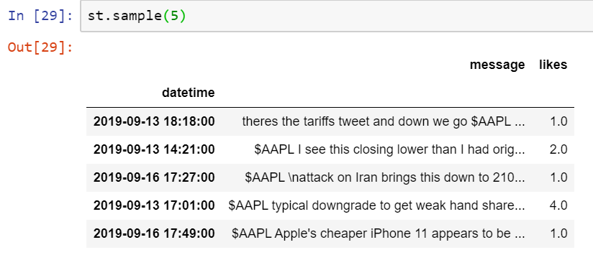
Cleaned data
Created a time-series as well
But its almost impossible to correct everything into proper sentences, correct all the spellings and syntax
Hence, a suitable model for SA was used

Slide 7
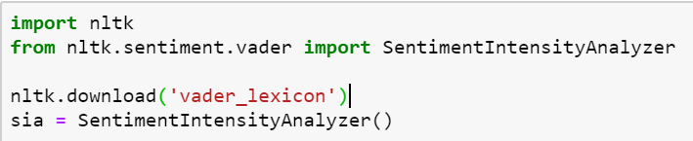
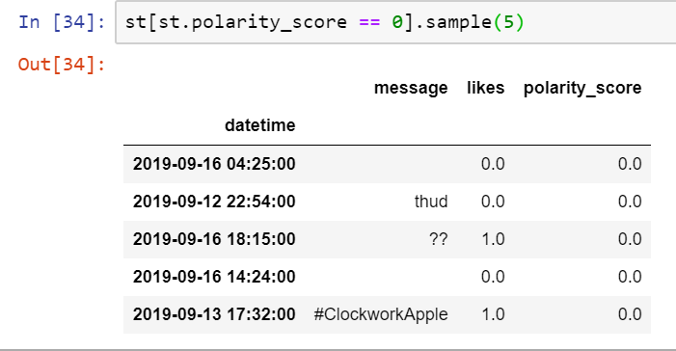
VADER
Valence Aware Dictionary for sEntiment Reasoning (VADER)
A pre-built SA model included in the NLTK package.
Return the polarity (+ve or –ve) as well as the strength of the emotion (intensity) of a text.
Eg – 0.6875
The outputs ranges from -1 to 1, with 0 being neutral
Score of exactly 0.0000 usually is just useless text,
and was removed

Slide 8
VADER explained
VADER is rule-based and relies heavily on humans rating texts via Amazon Mechanical Turk — a crowd-sourcing e-platform which utilizes human intelligence to perform tasks that computers are currently unable to do
Focused on social media and short texts, unlike Financial News which are almost the opposite.
The human raters of Vader used 5 heuristics to analyse the sentiment:
Punctuation — I love pizza vs I love pizza!!
Capitalization — I’m hungry!! vs I’M HUNGRY!!
Degree modifiers (use of intensifiers)— I WANT TO EAT!! VS I REALLY WANT TO EAT!!
Conjunctions (shift in sentiment polarity, with later dictating polarity) — I love pizza, but I really hate Pizza Hut (bad review)
Preceding Tri-gram (identifying reverse polarity by examining the tri-gram before the lexical feature— Canadian Pizza is not really all that great.

Slide 9
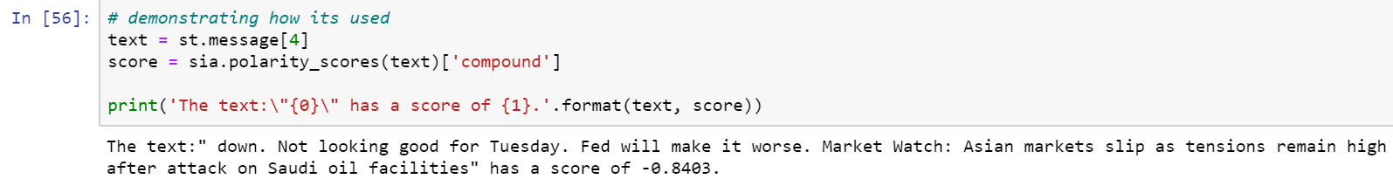
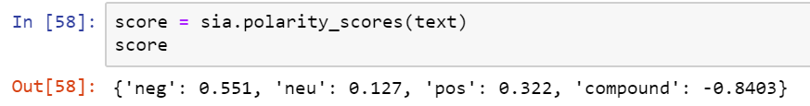
How is VADER used?

Slide 10
Updating Vader Lexicon with external sources/lexicons such as the Loughran-McDonald Financial Sentiment Word Lists, to make the SA more robust

